Slide 1
Multi-robot Transport System
Decentralized design
Pitch 12-06-2017
Minor Adaptive Robotics
Fontys 2017
Notes:
1

Slide 2
Table of Contents
Mechanical design
Software
Goals
Minor Progress
Notes:
2

Slide 3
Mechanical design
Functional test gripper build
3D Printed
Material was too weak, often broke
One turtlebot being assembled
Last components delivered this week
Notes:
3

Slide 4
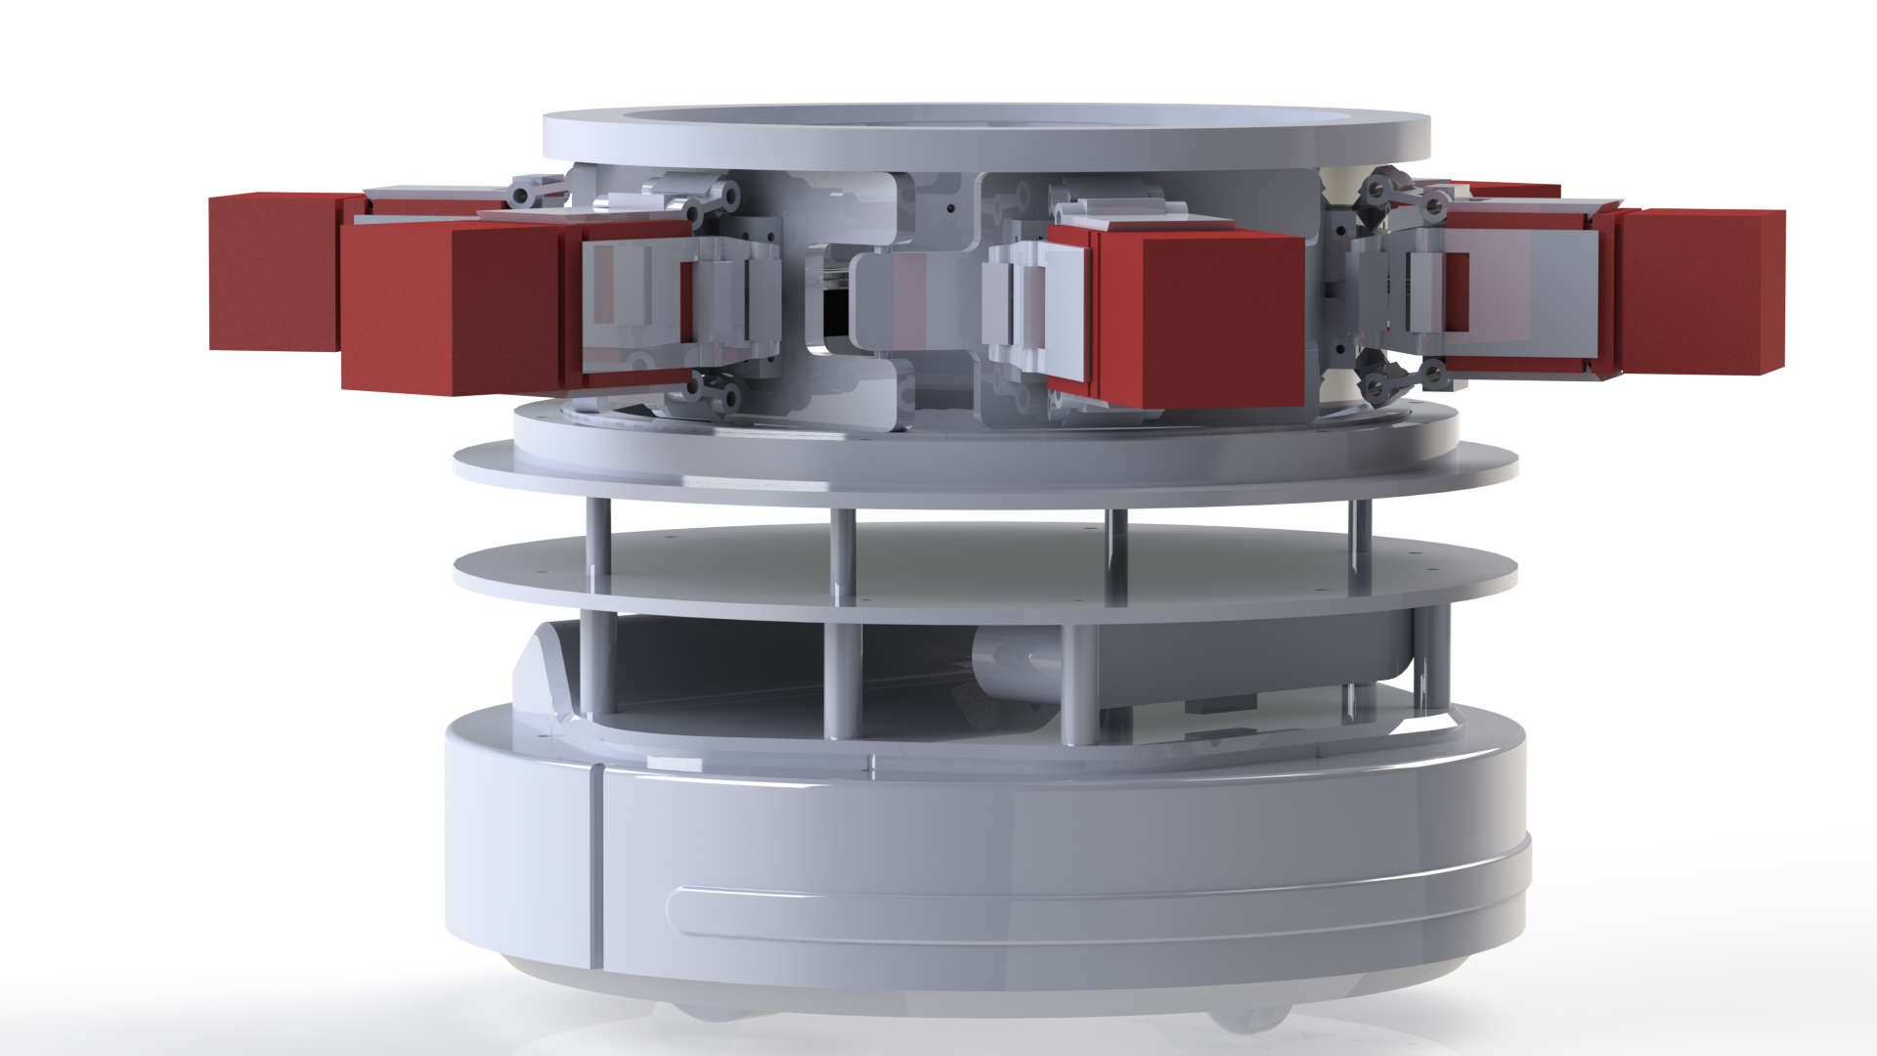
Notes:
4

Slide 5
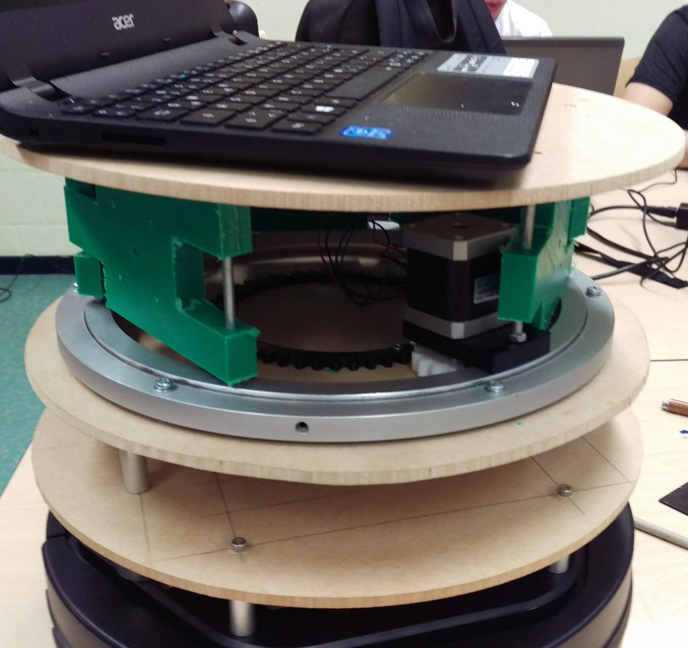

Slide 6
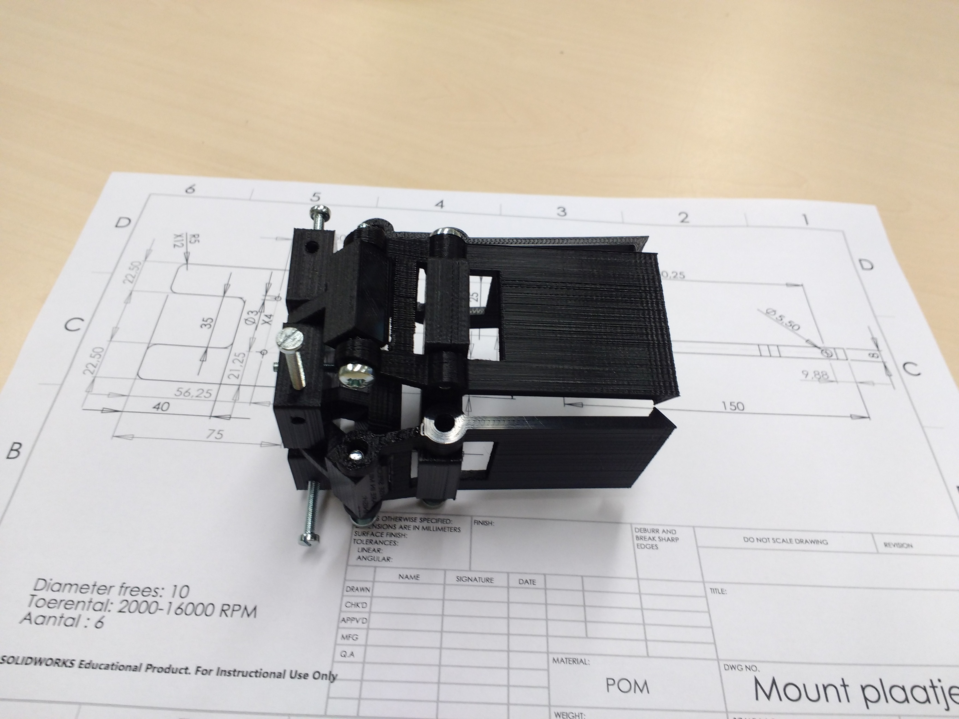
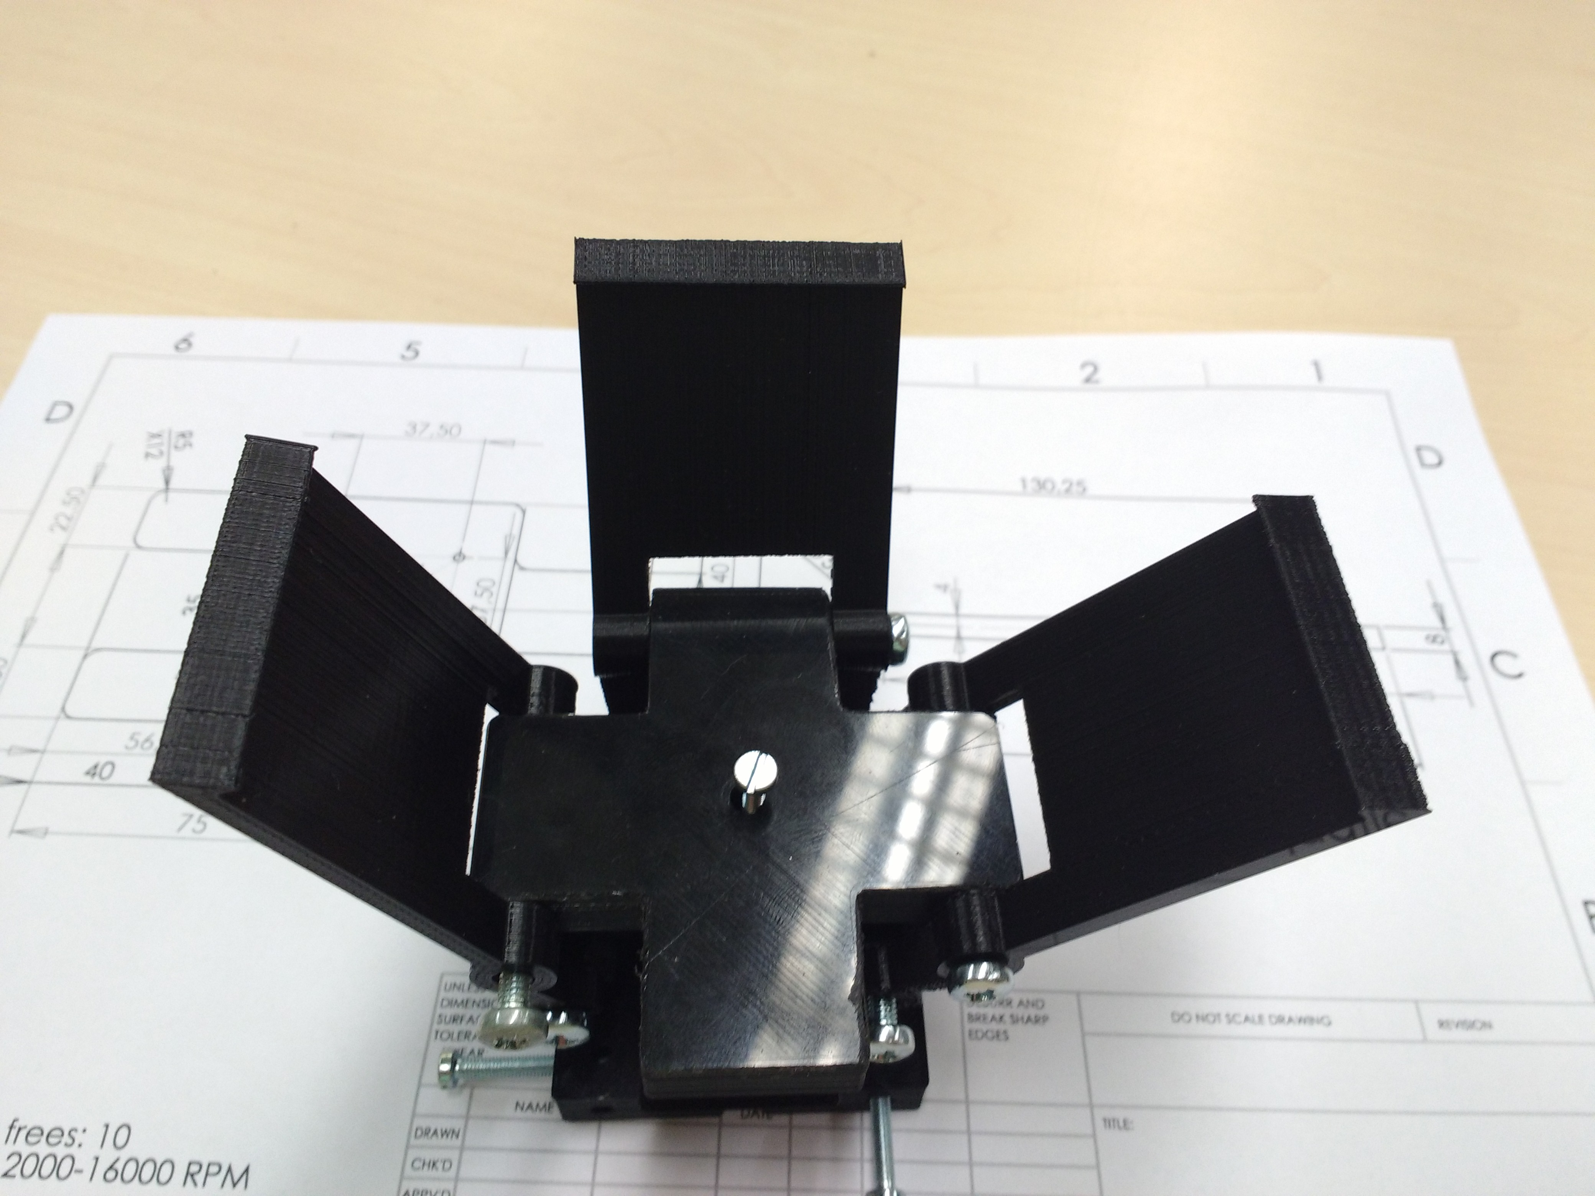
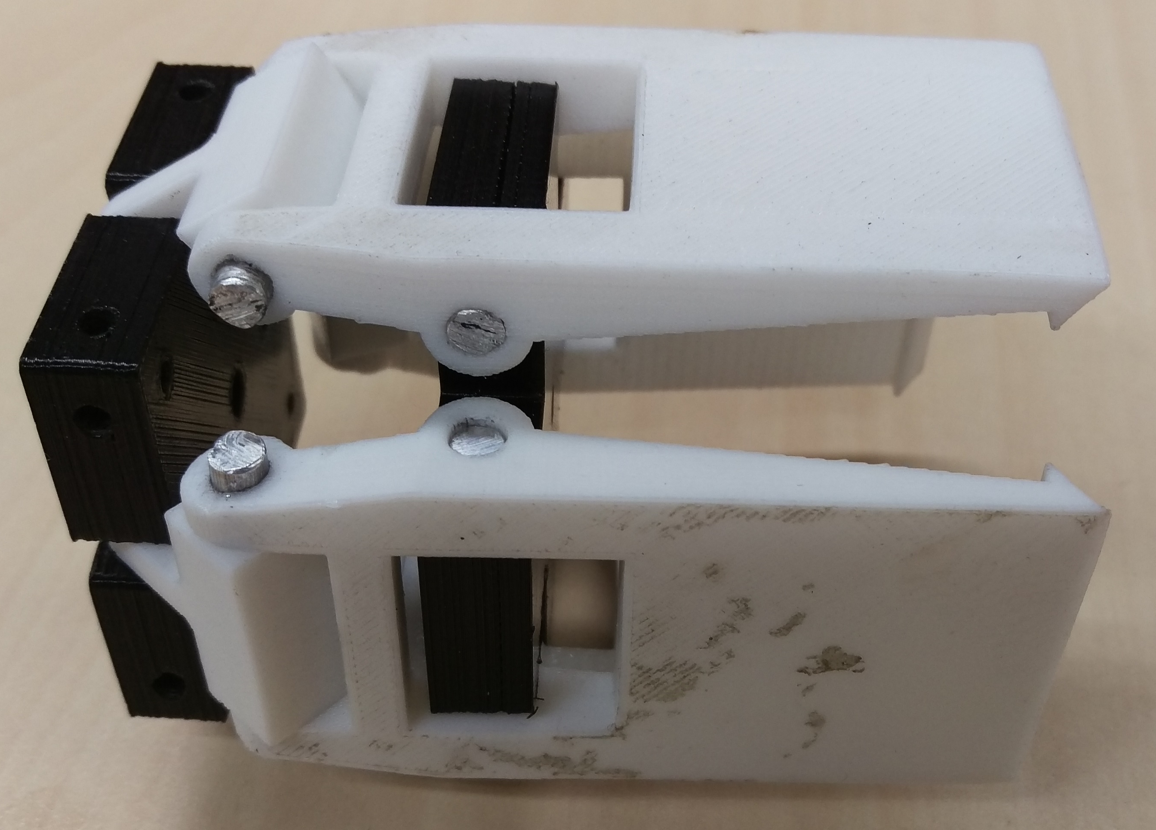
Notes:
6

Slide 7
Software
Decision logic
Inventory check
Notes:
7

Slide 8
Goals
Prototype of the loader
Simulate product transfer
Real world test
Paper
Poster
Notes:
8

Slide 9
Minor Progress
Notes:
9

